Slide 1
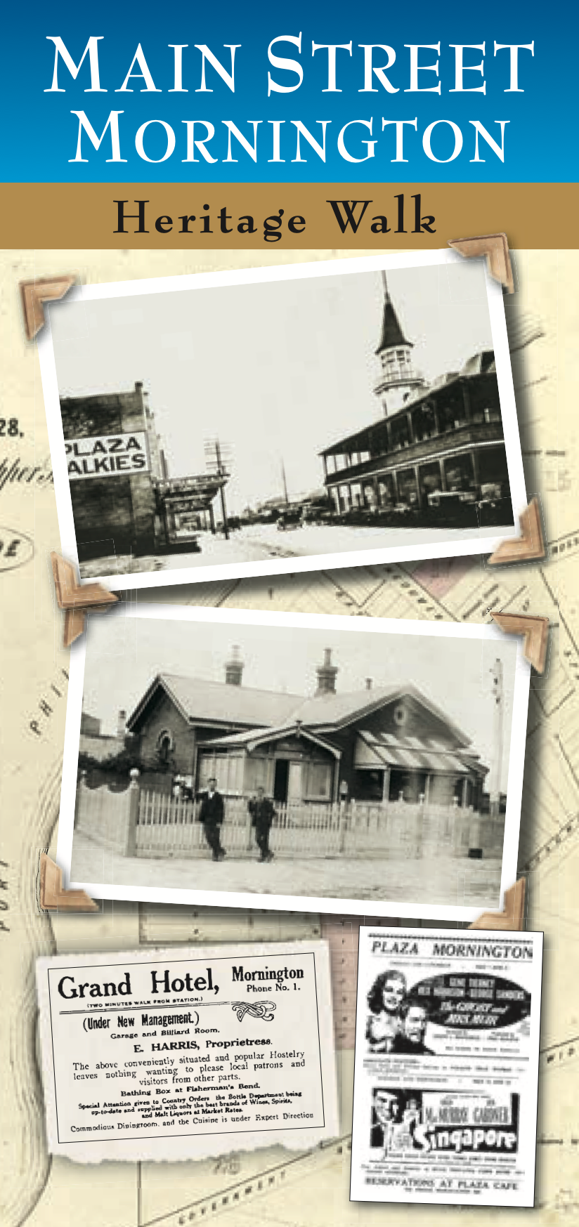
Main Street Mornington
Picture Tour
to be viewed in conjunction with the audio tour
http://morningtondistricthistory.org.au/mornington-mainstreet-audio-tour/

Slide 2
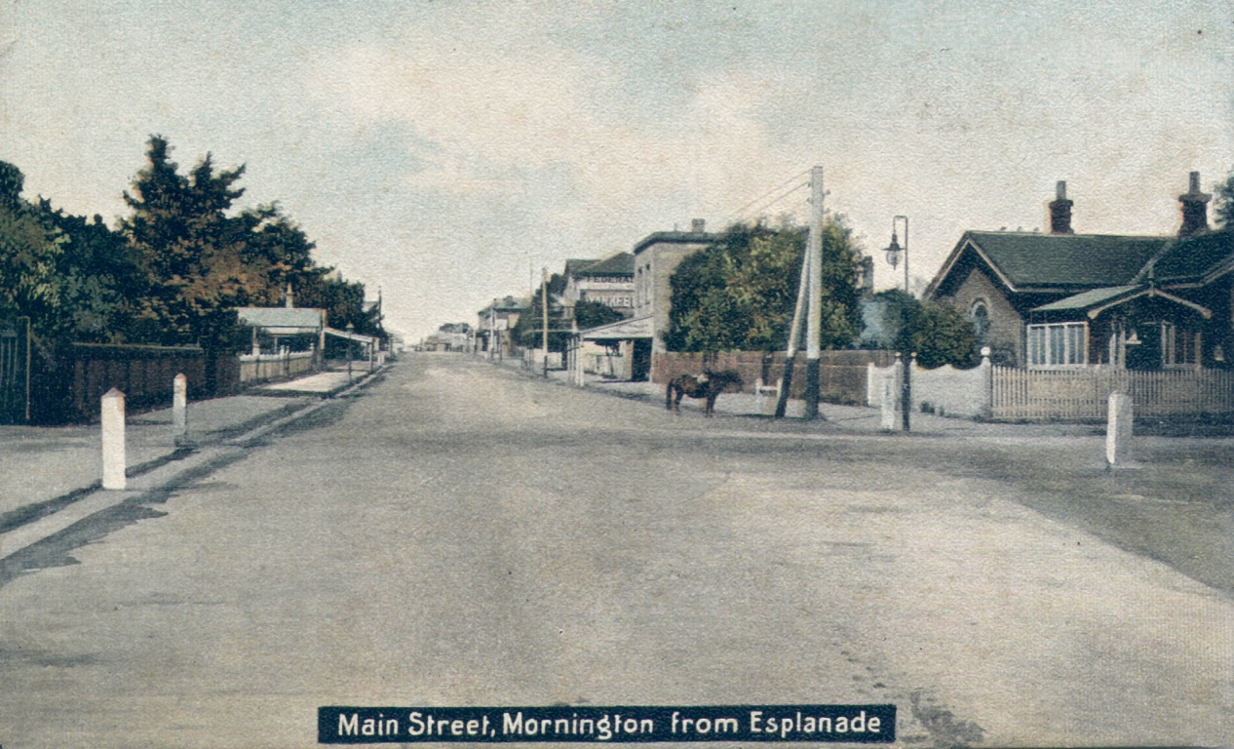

Slide 3
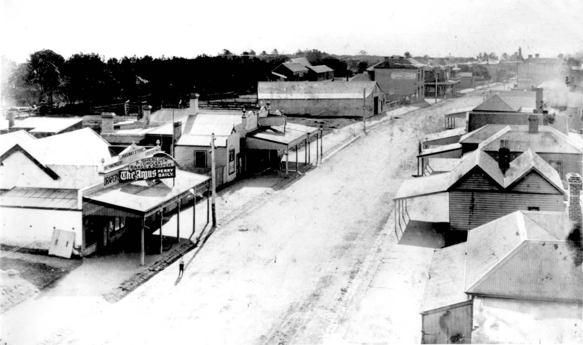
Bird’s eye view to north

Slide 4
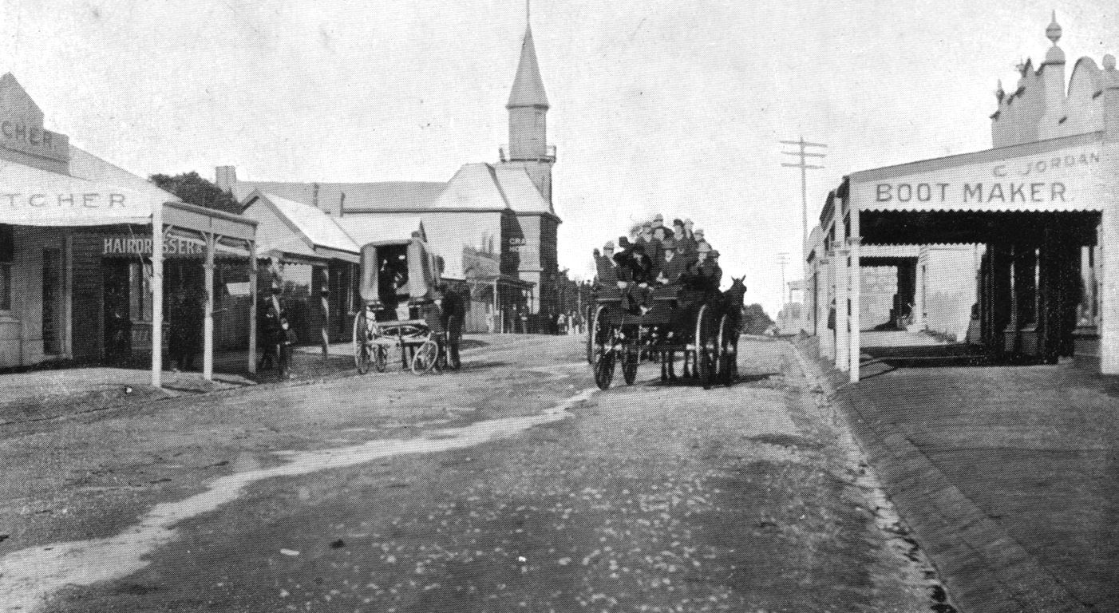
Towards Grand Hotel c.1900

Slide 5
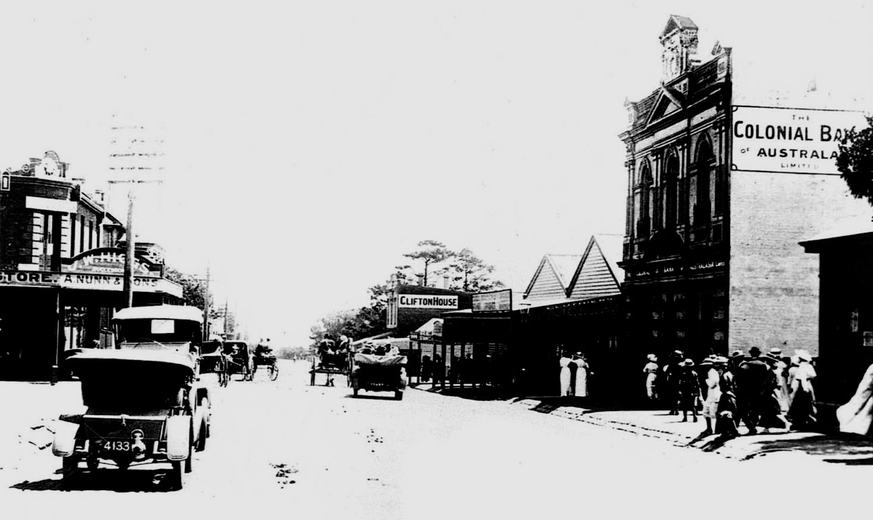
Train just arrived c.1920

Slide 6
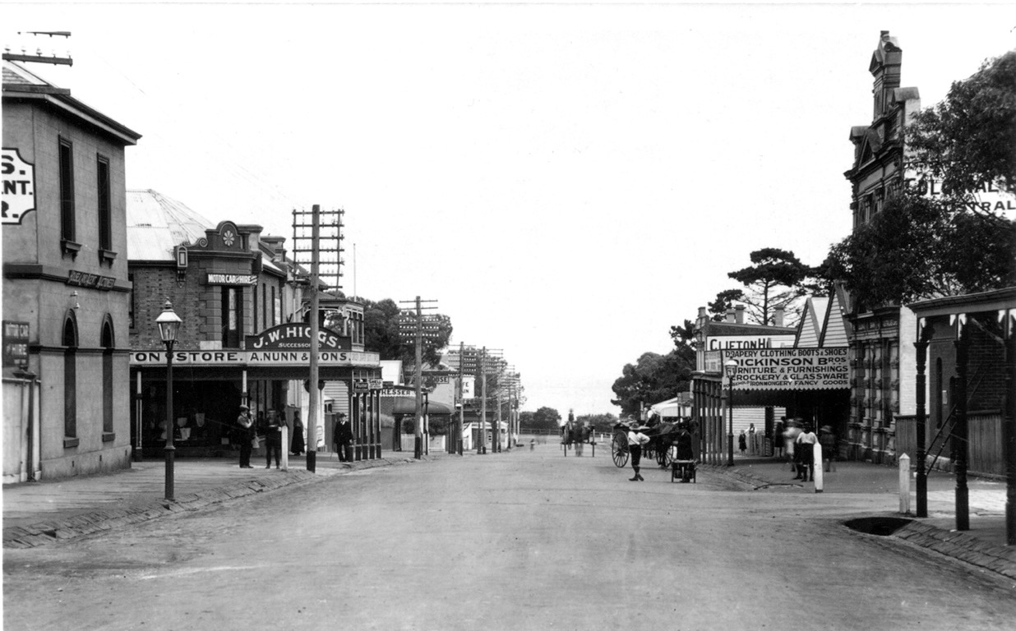
c.1910

Slide 7
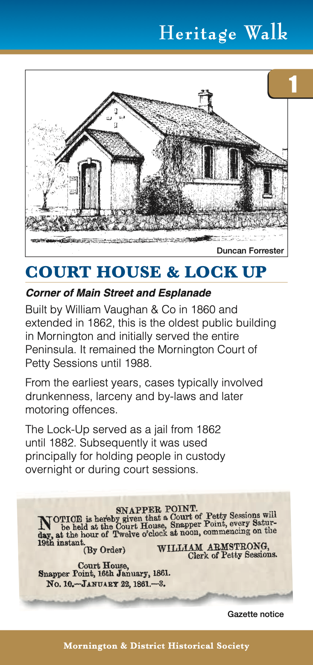
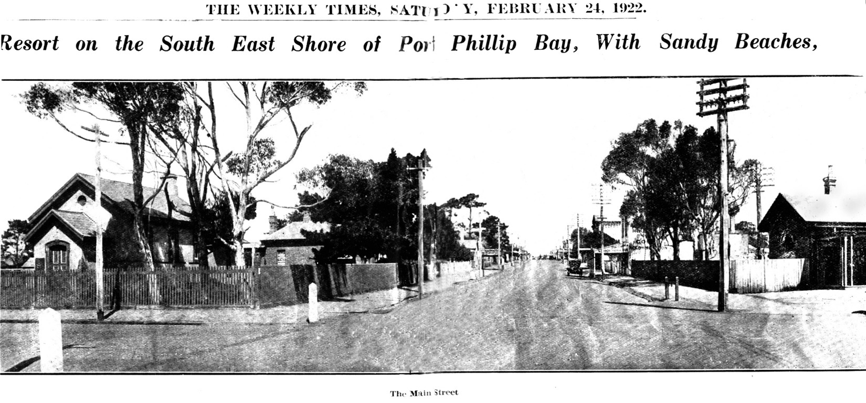
1922

Slide 8
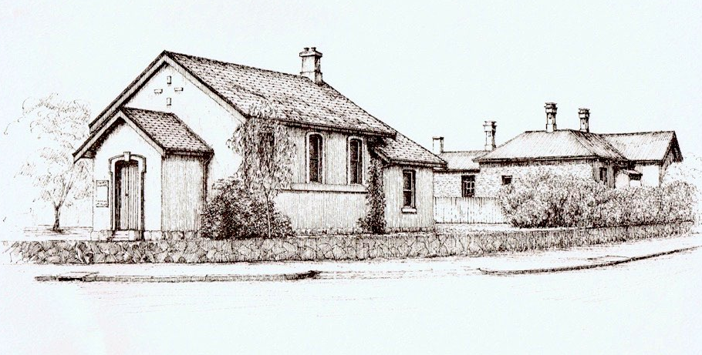
Courthouse and Police Station

Slide 9
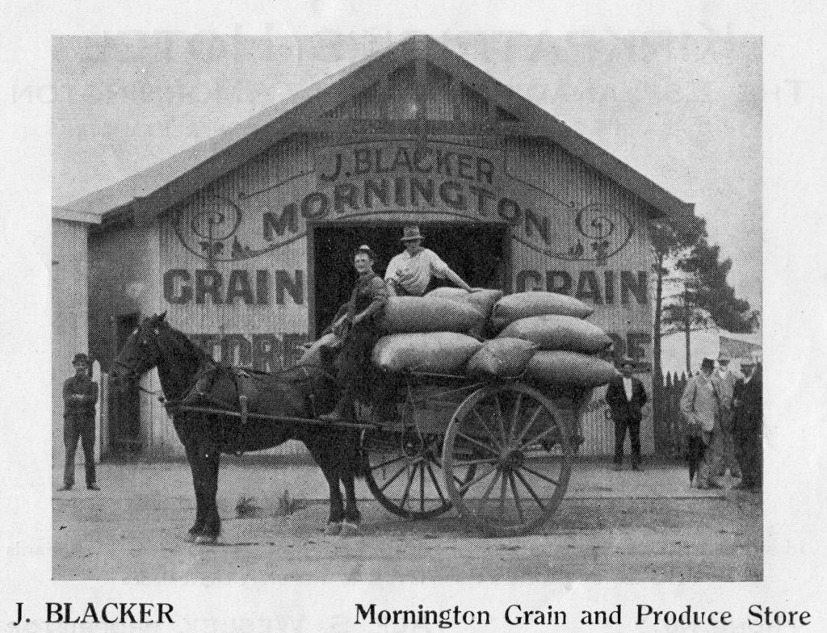
J. Blacker - see also Plaque 11

Slide 10
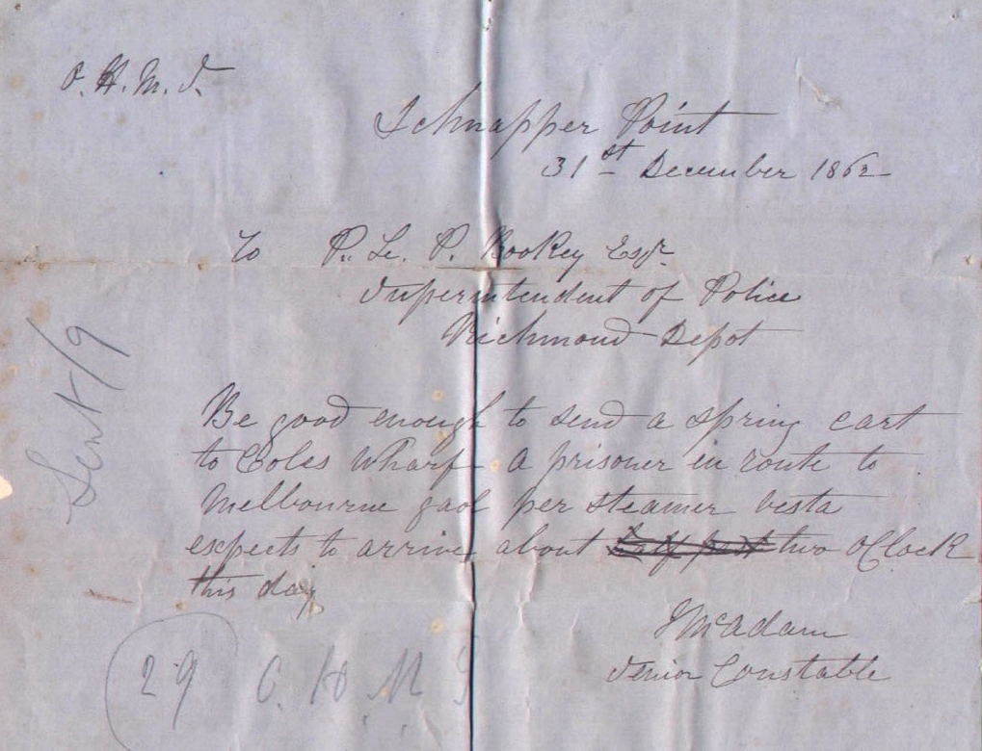
Telegram sent 1862

Slide 11
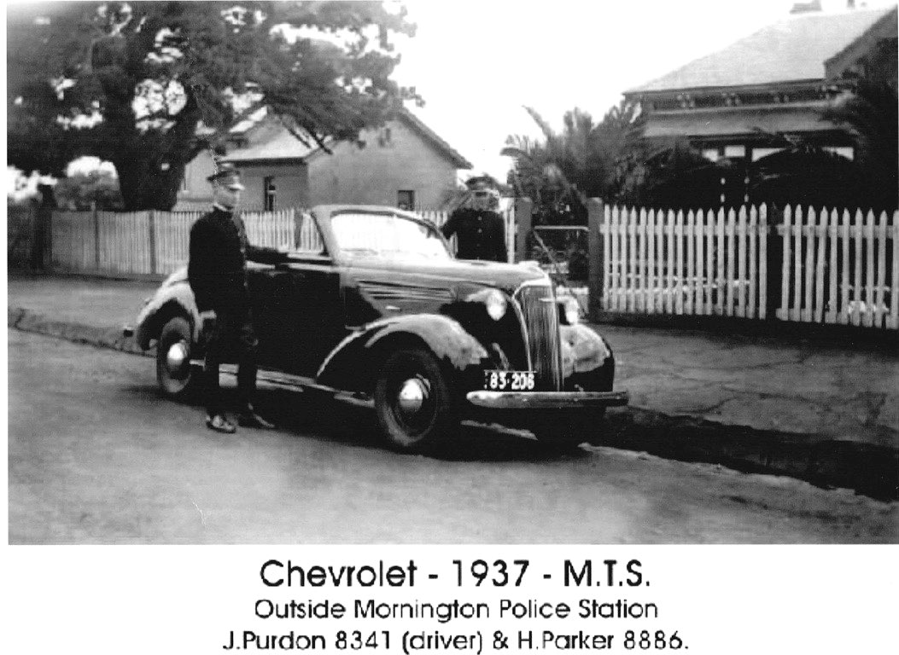

Slide 12
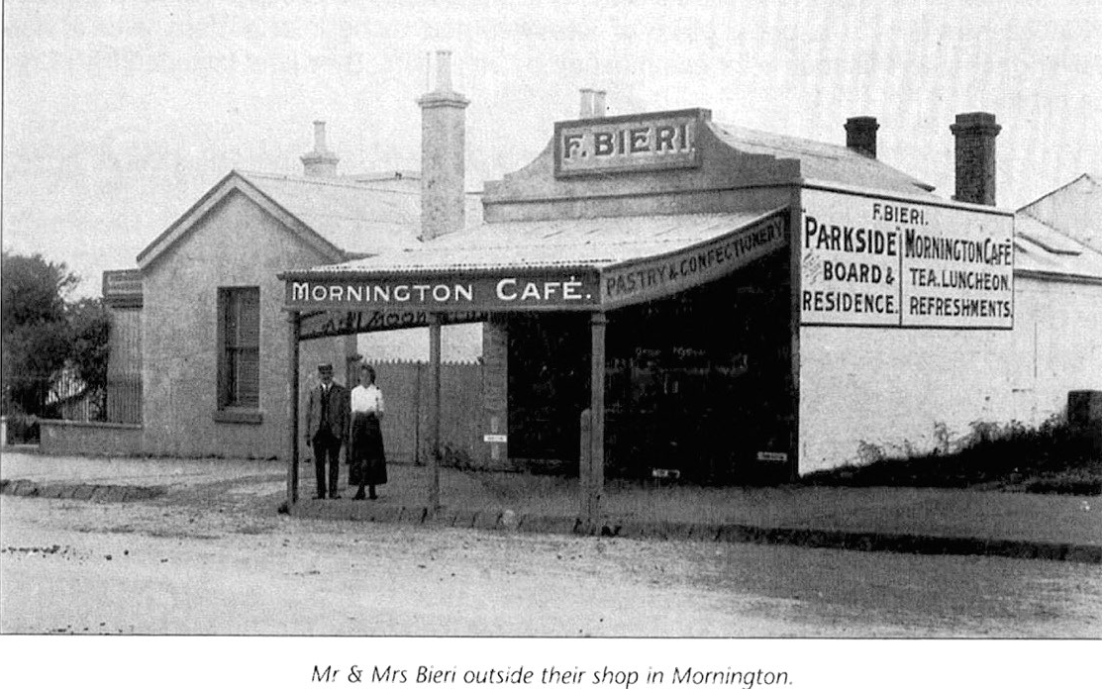
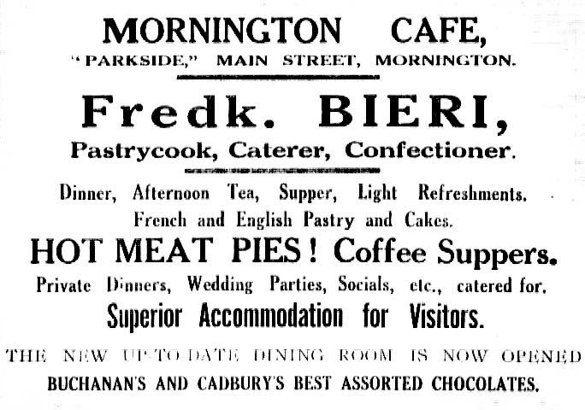
Bieri’s cafe

Slide 13
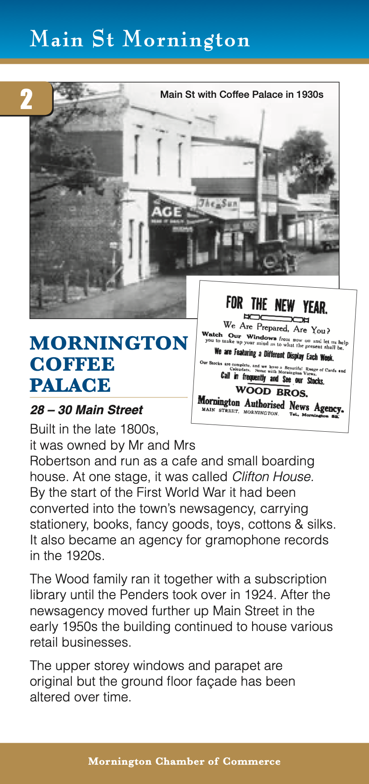
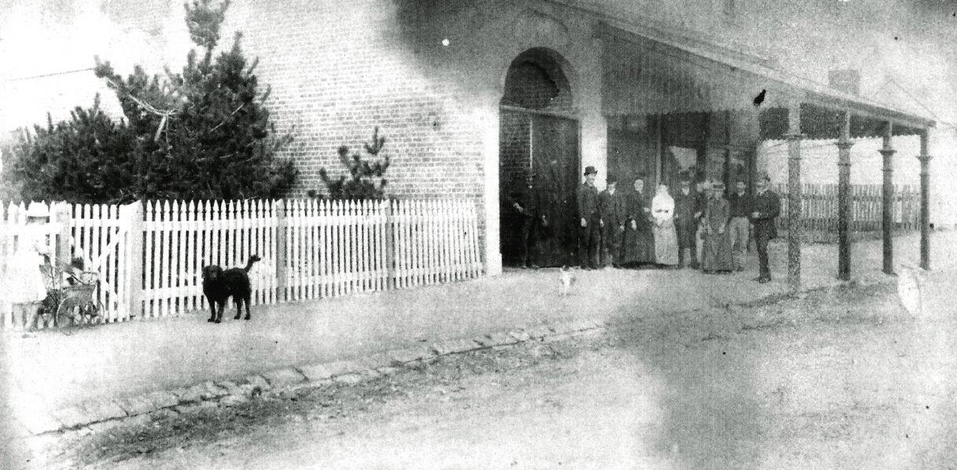
When it was a funeral parlor.
Note the picket fence of the school

Slide 14
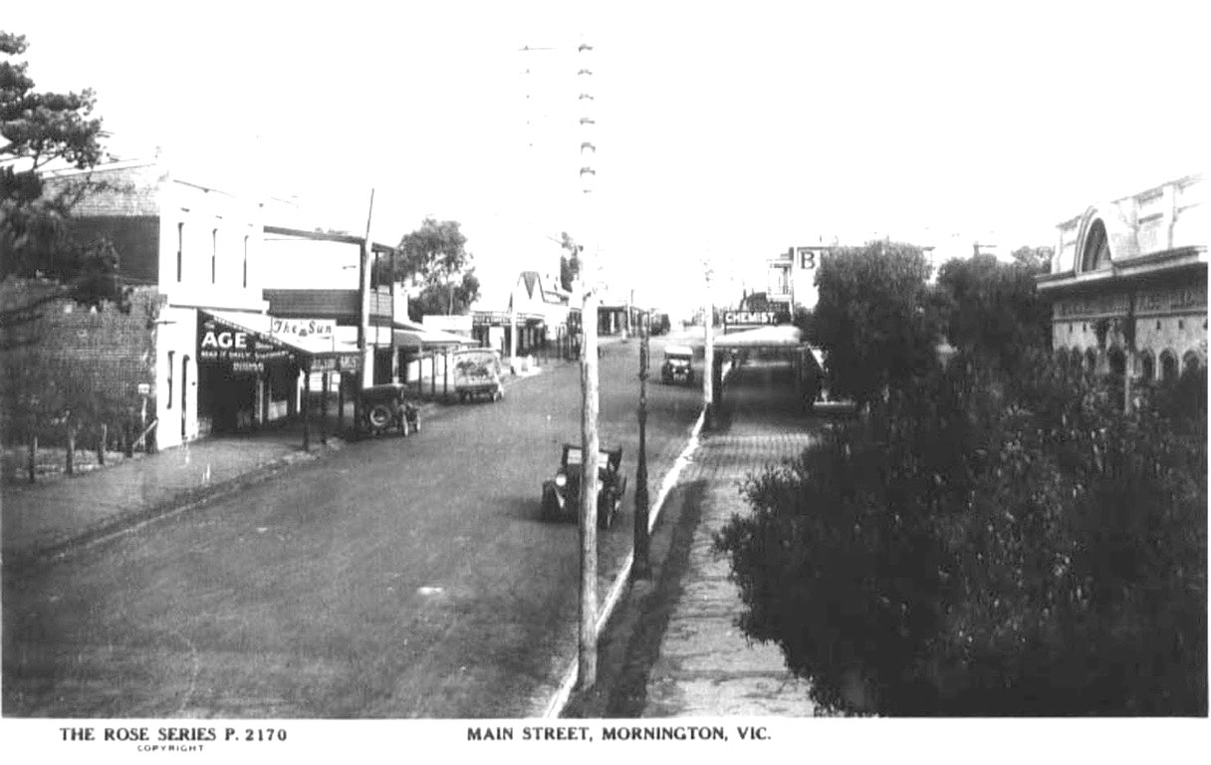
Coffee palace on left when it was newsagency

Slide 15
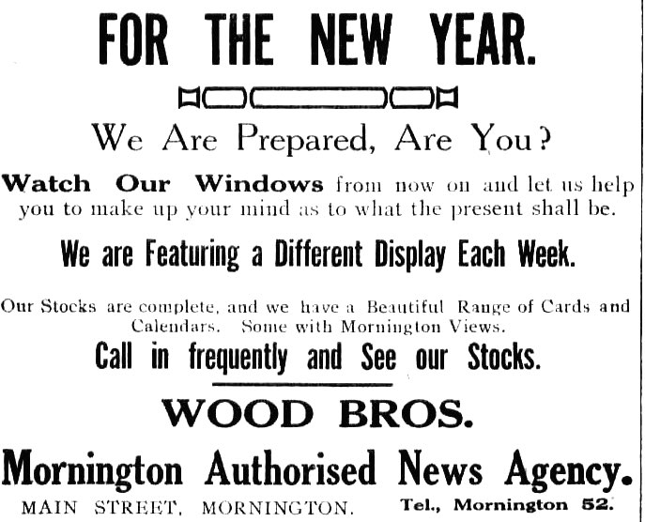
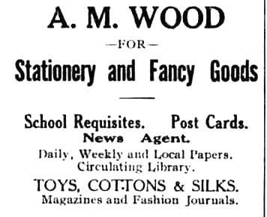

Slide 16
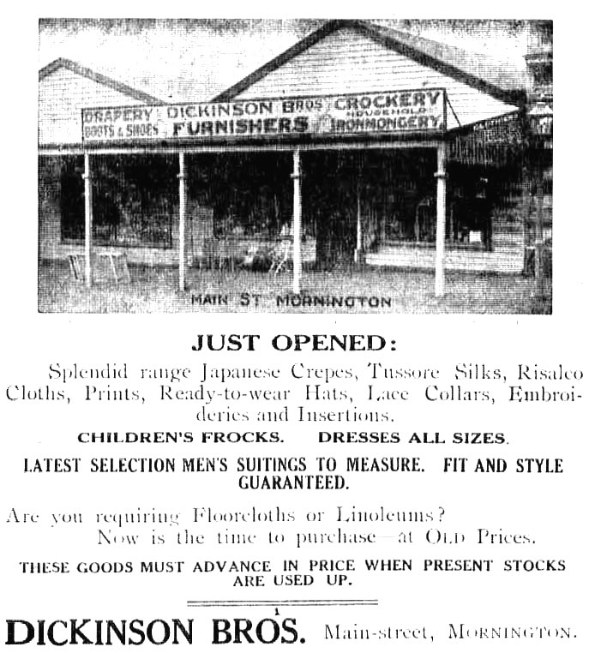
Continuing up the street. . .

Slide 17
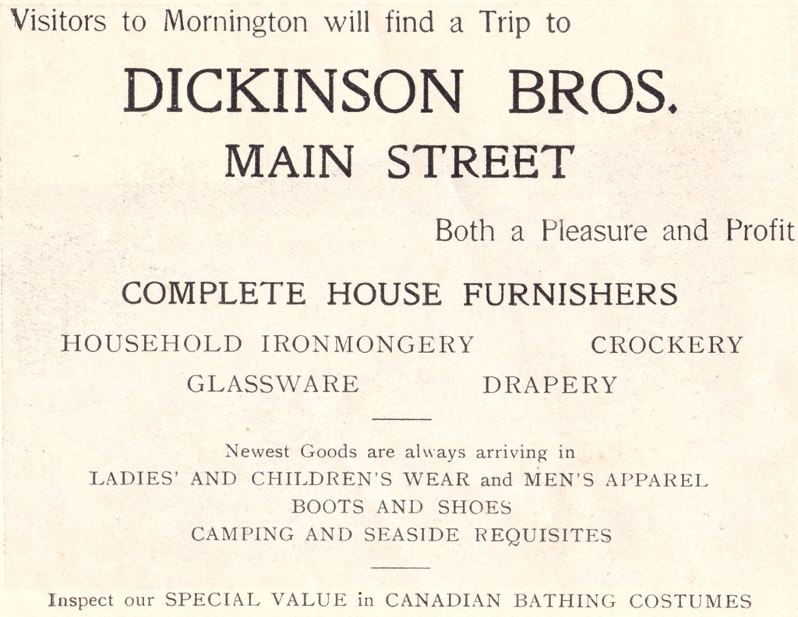
... and also

Slide 18
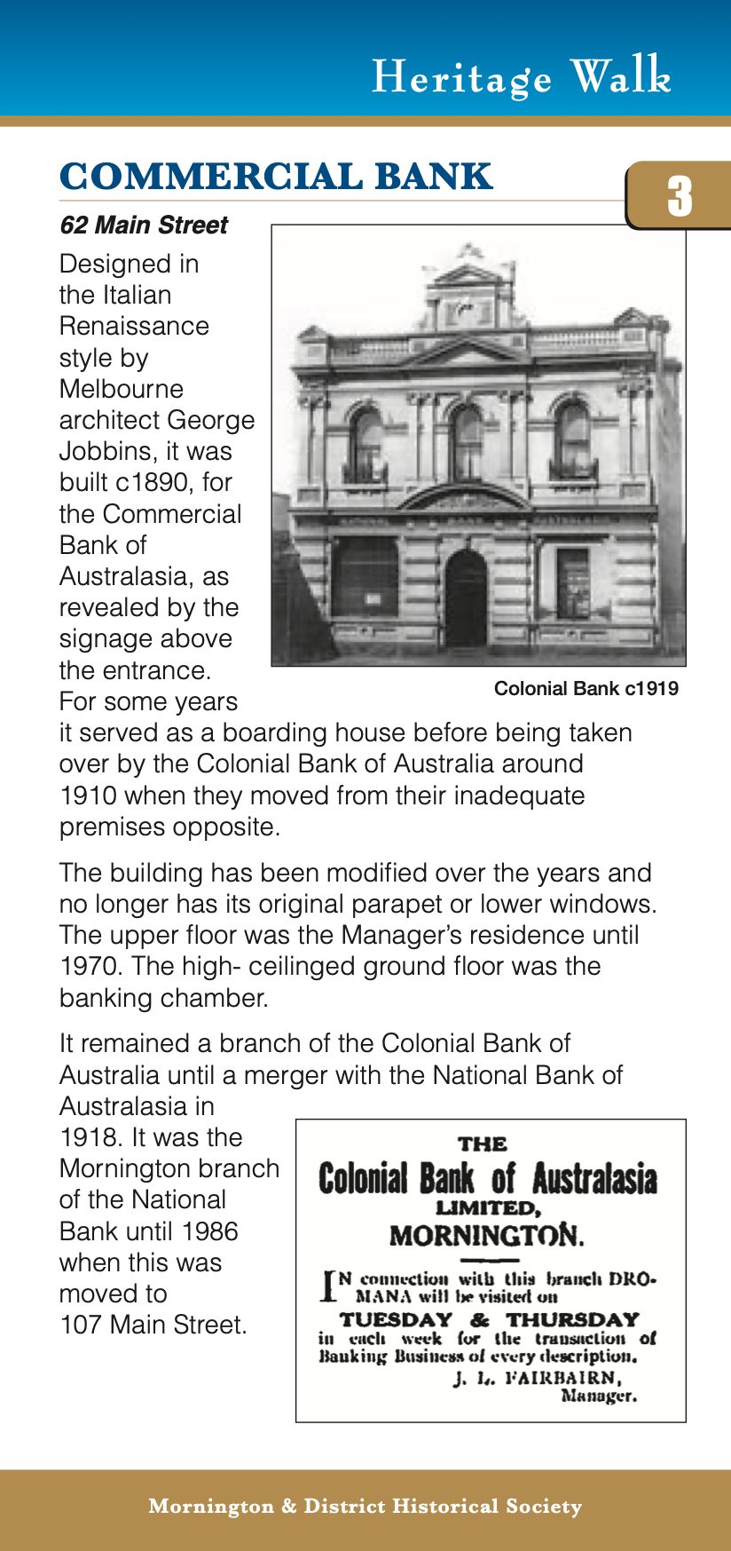
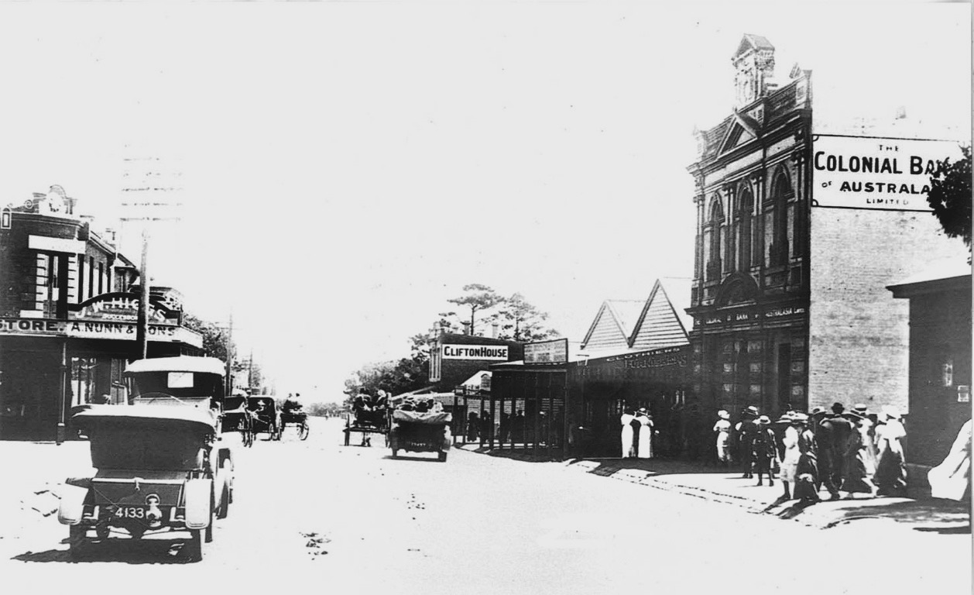
The Bank on the right

Slide 19
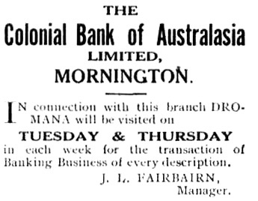

Slide 20
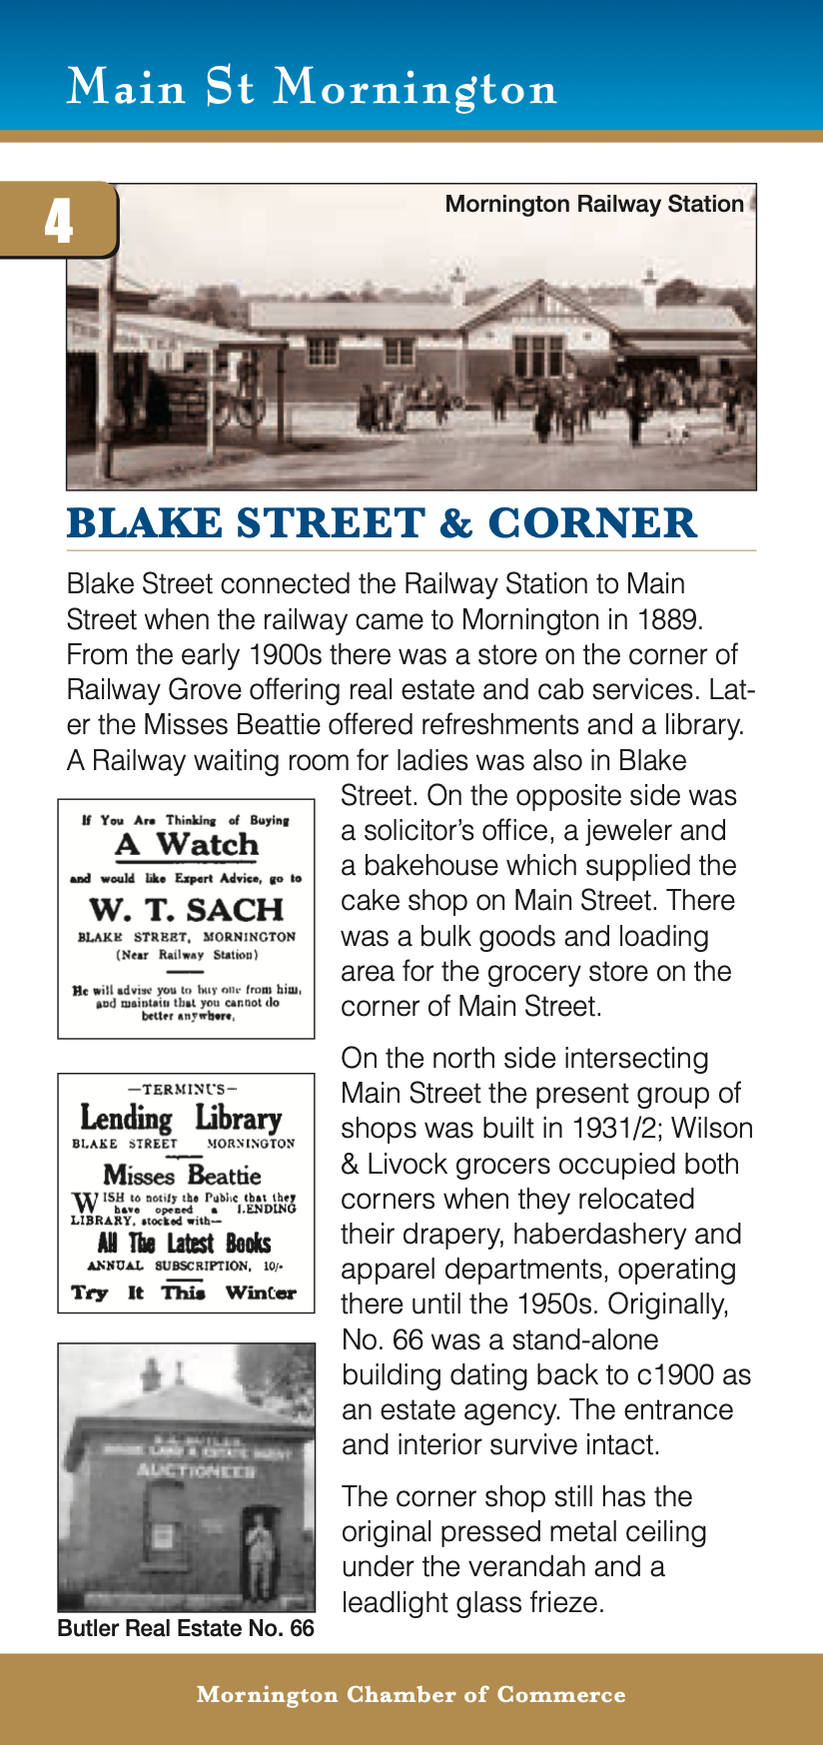
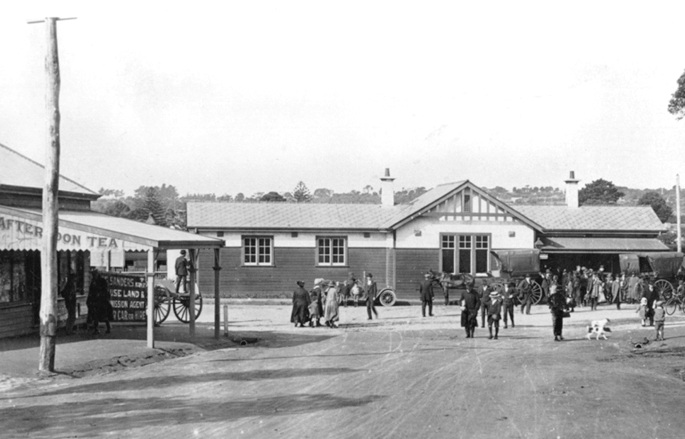
Passengers leaving the station

Slide 21
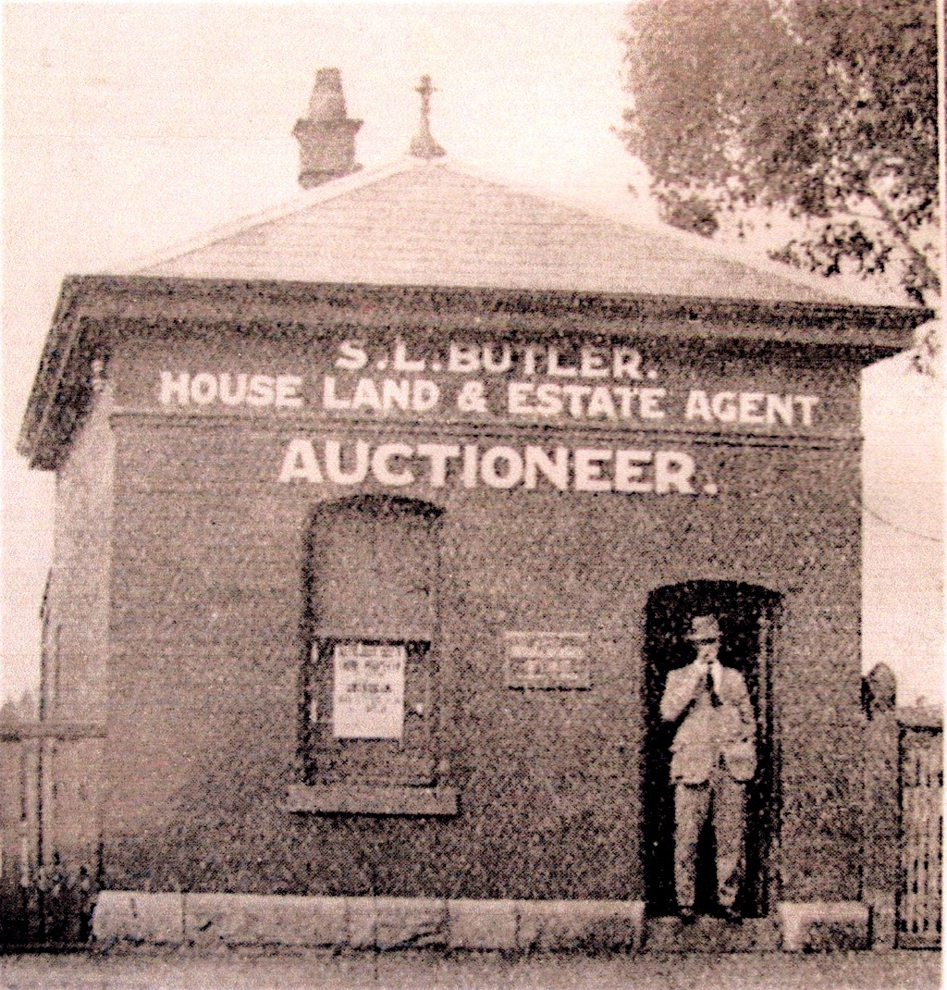
Butler’s Real Estate.
Doorway and step can still be seen

Slide 22
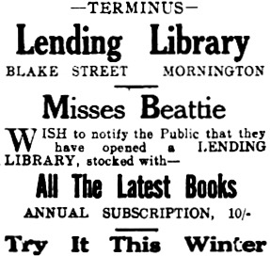
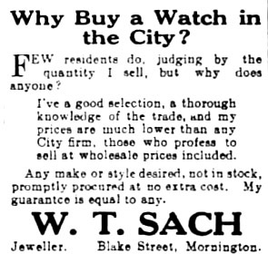
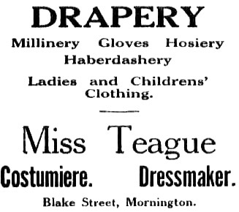
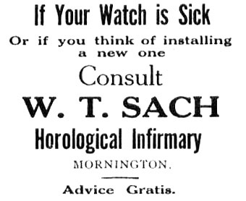
Various businesses in Blake Street

Slide 23
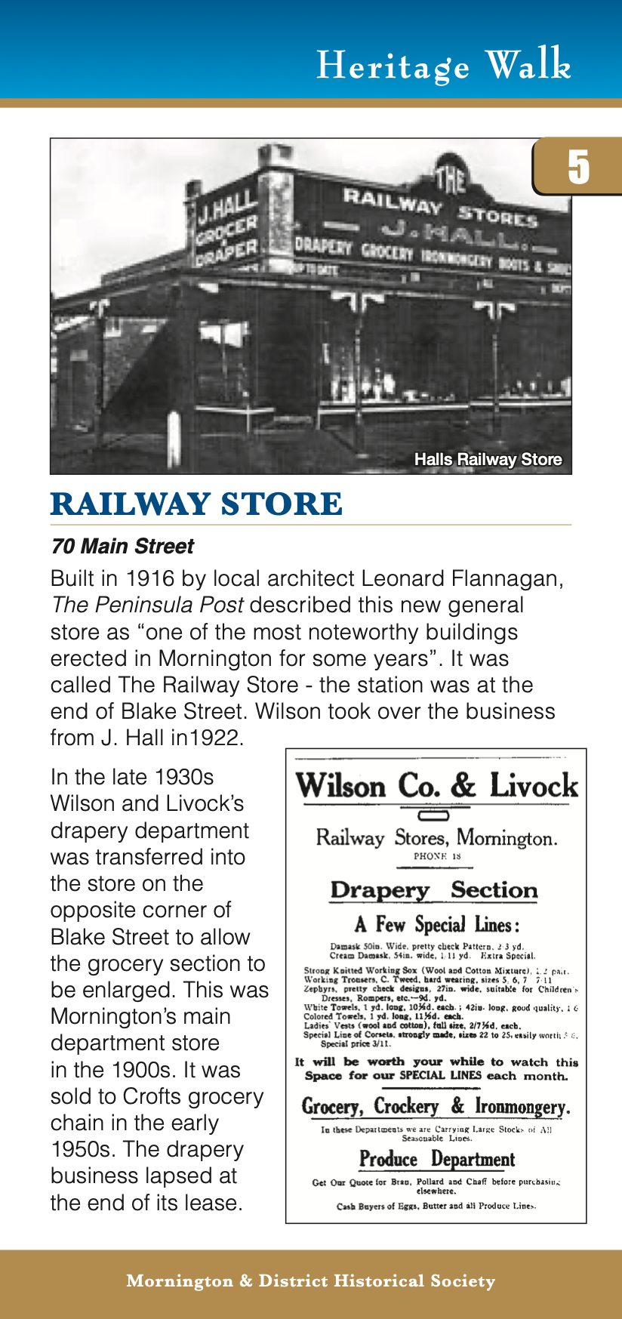
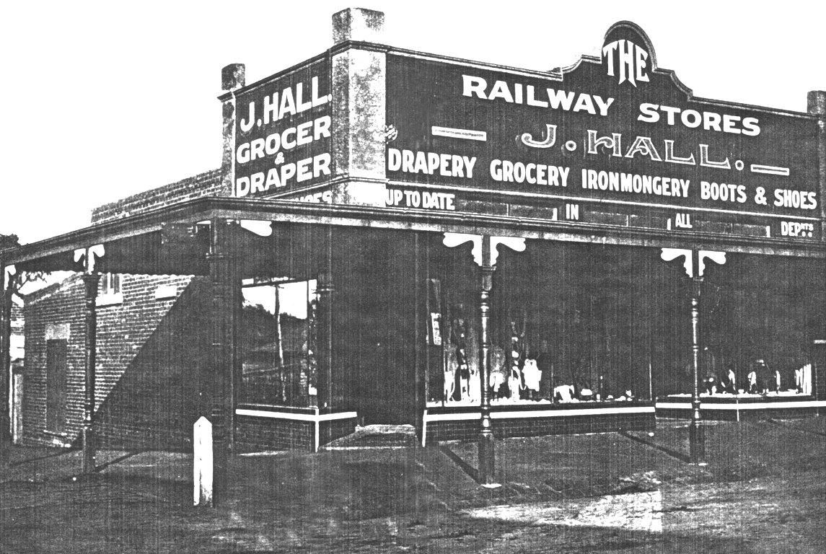
c. 1916 just after it was built

Slide 24
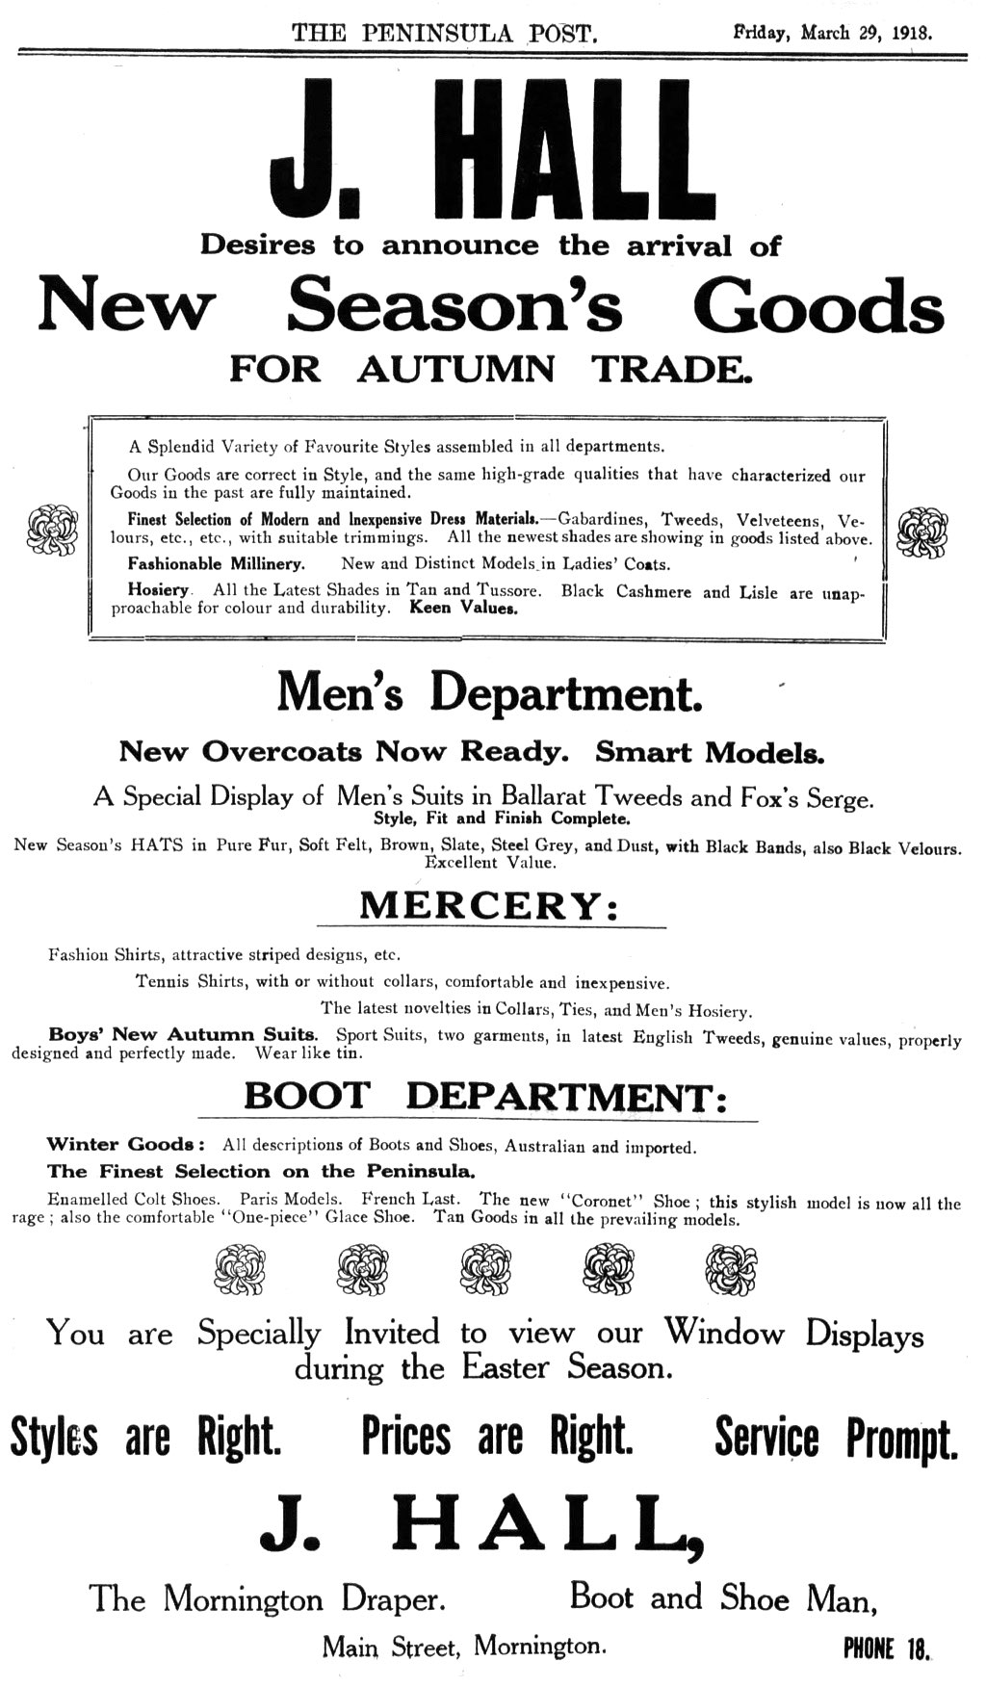

Slide 25
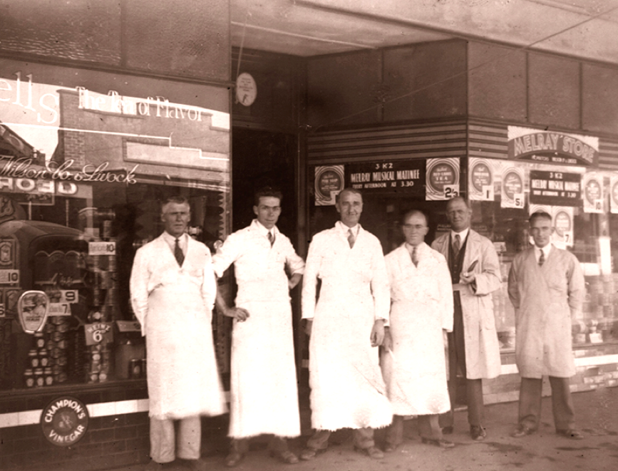
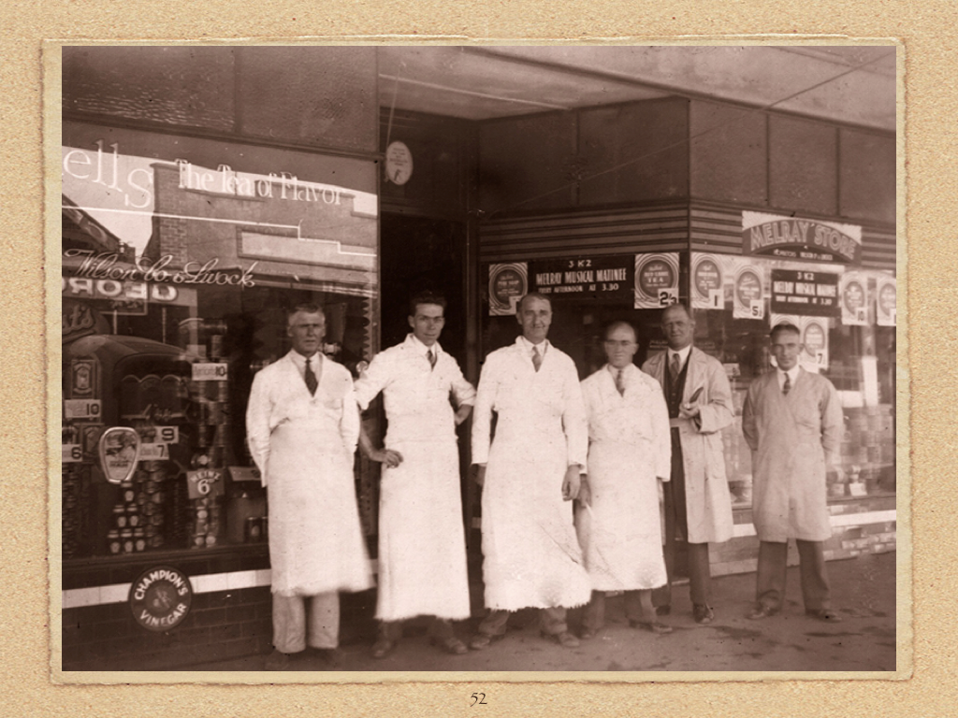
Wilson and Livock’s staff

Slide 26
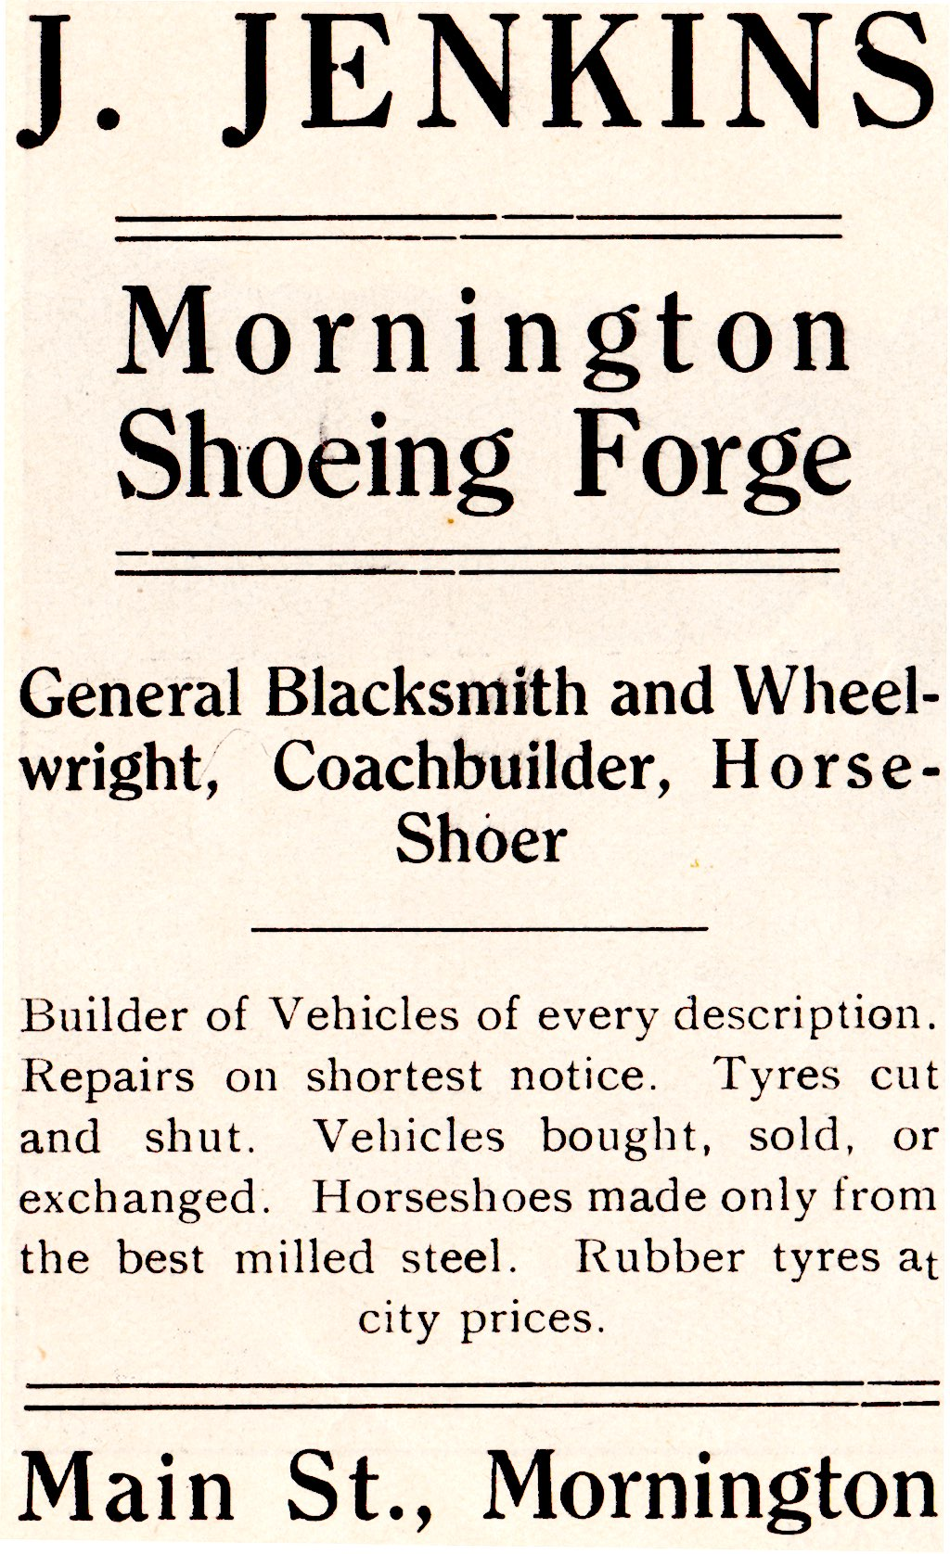
As you travel along the street to the Hotel

Slide 27
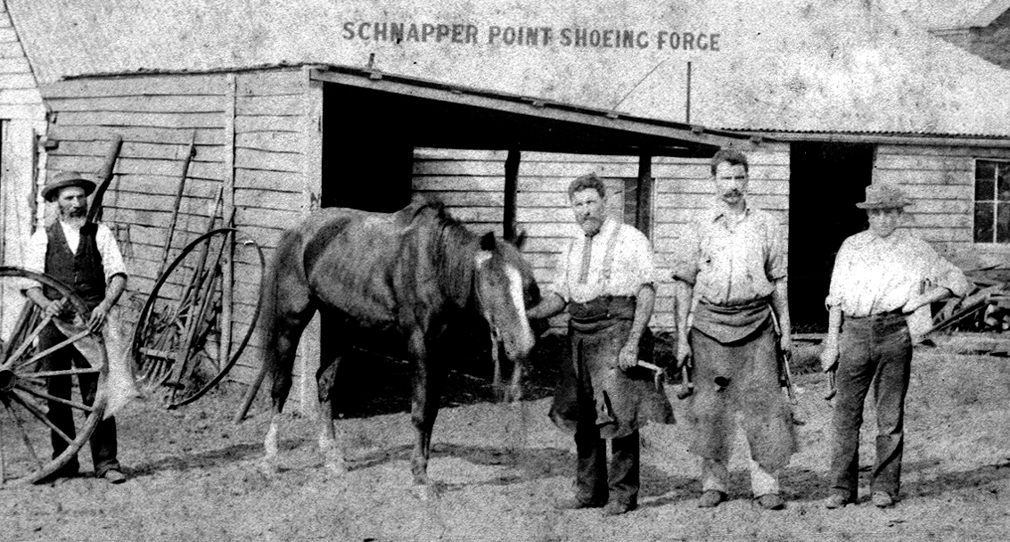
The Forge was down behind the shops

Slide 28
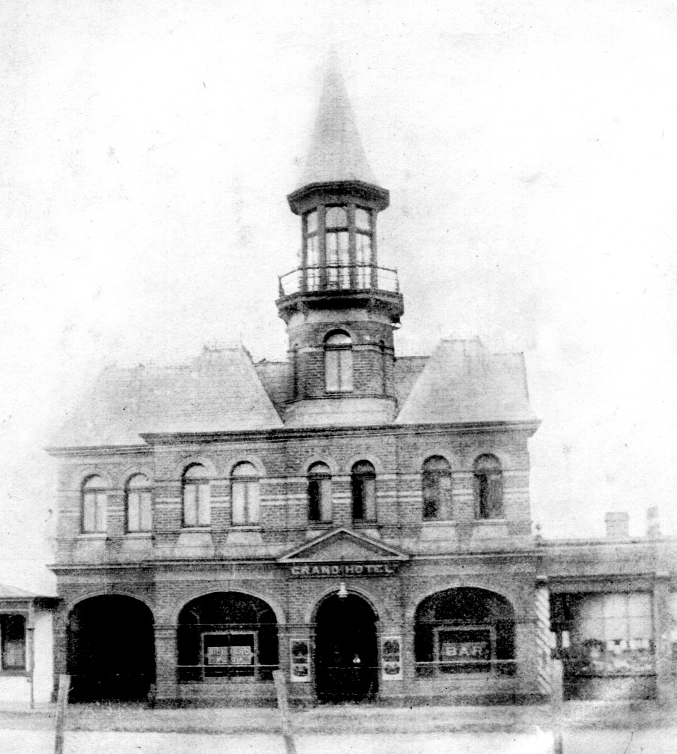
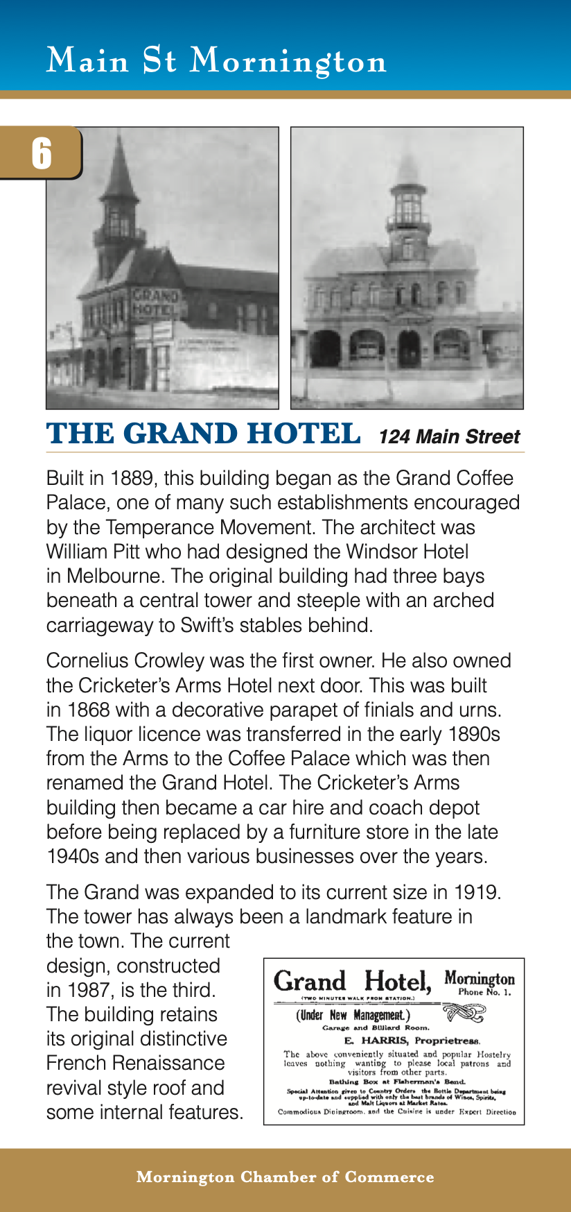
1890s. Note the barber’s shop on right

Slide 29
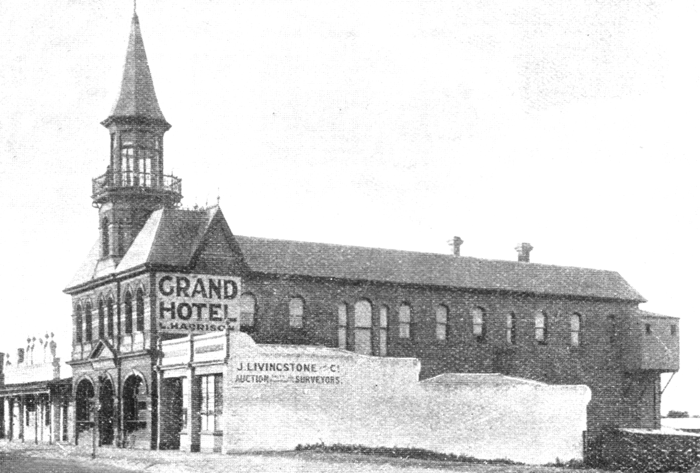
Another view - note the Cricketer’s Arms Hotel on the left

Slide 30
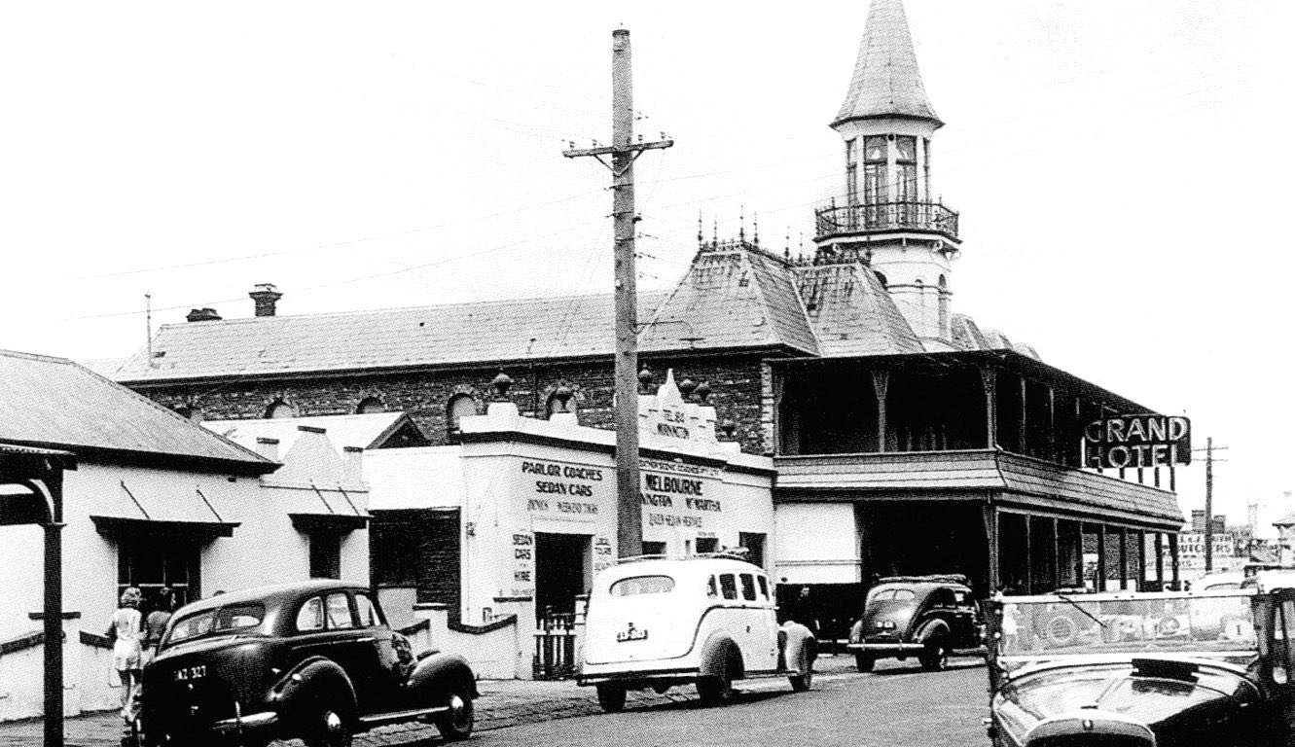
1930s/40s

Slide 31
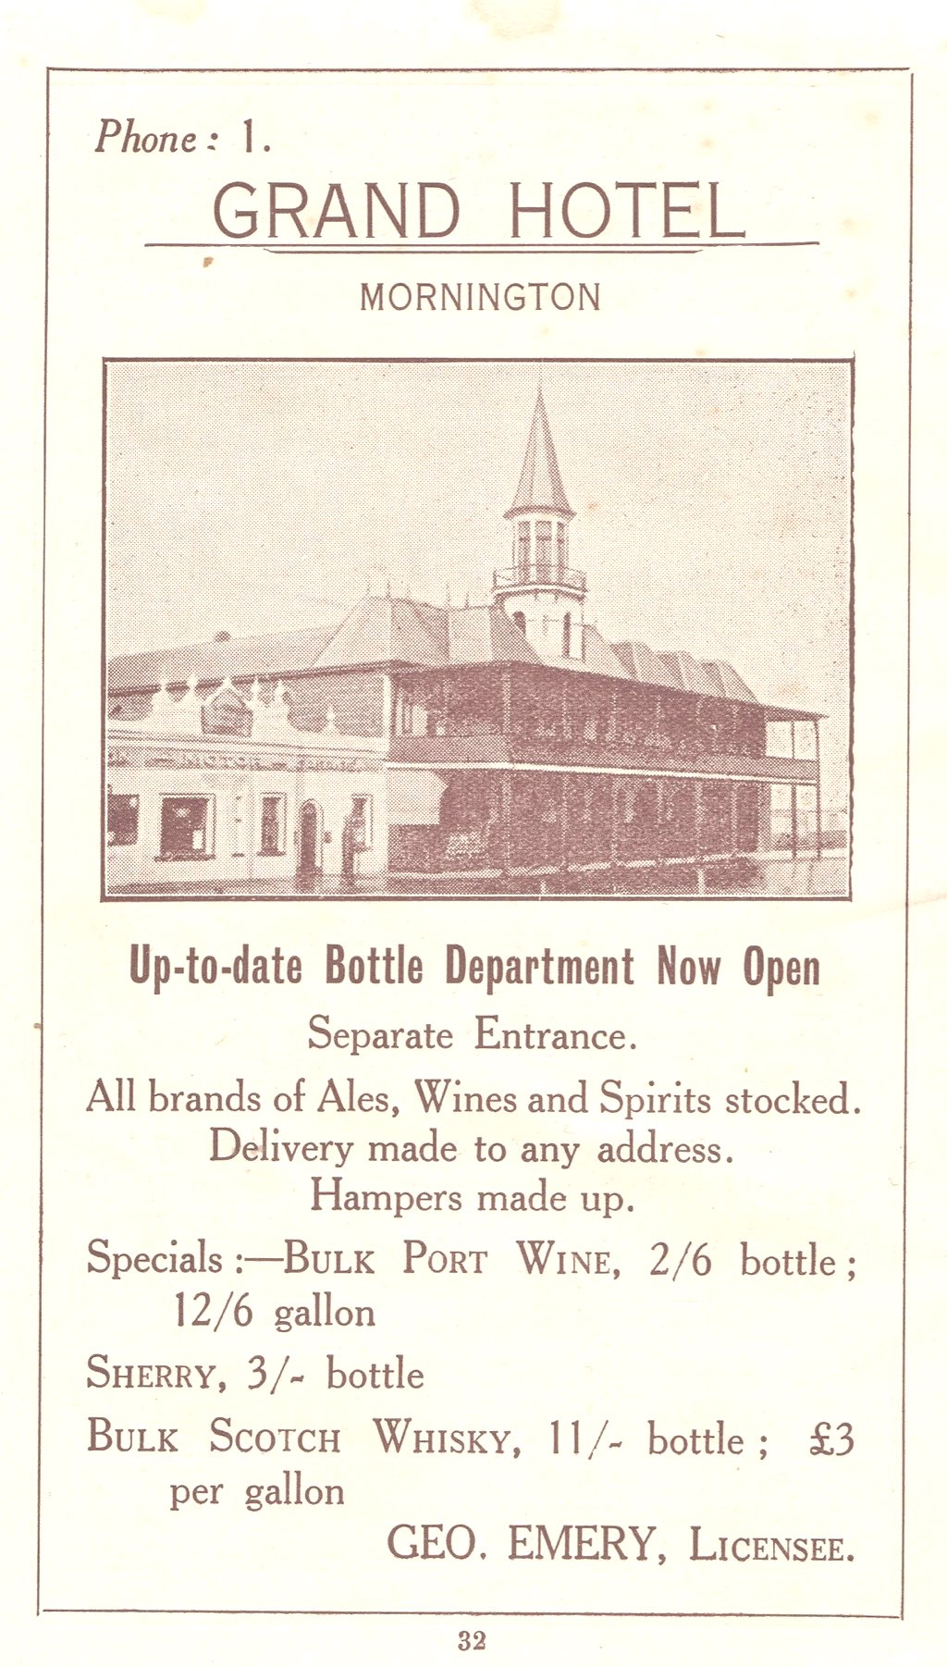

Slide 32
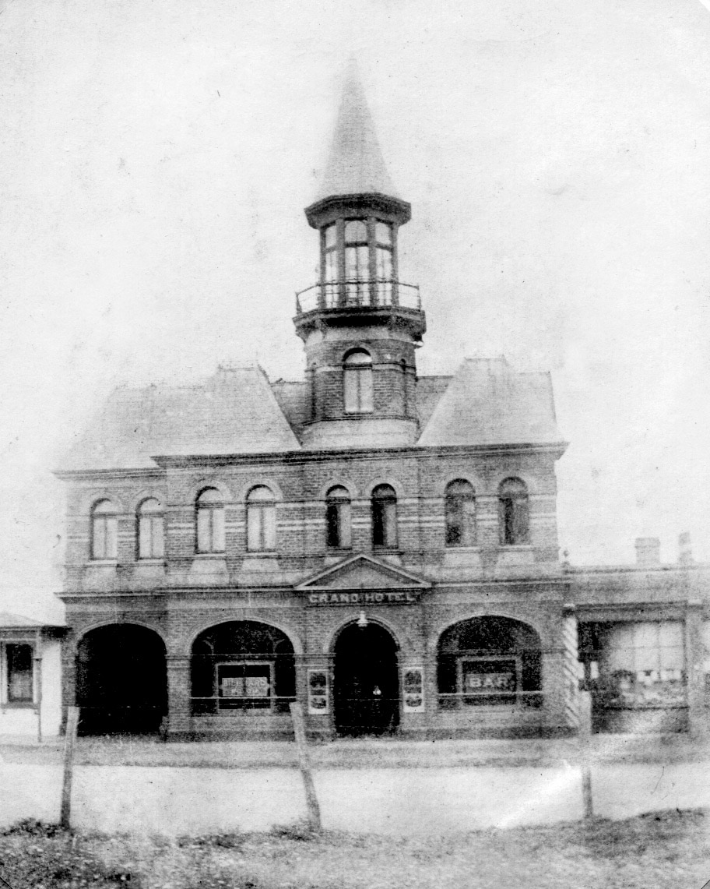
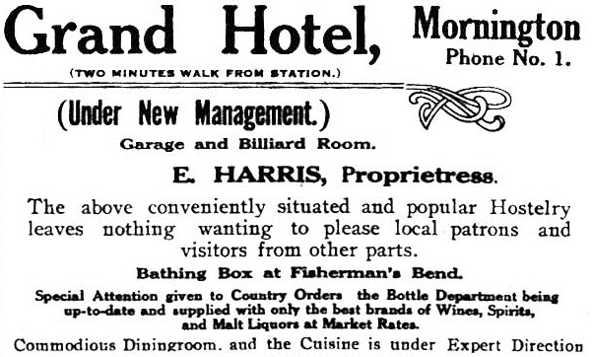

Slide 33
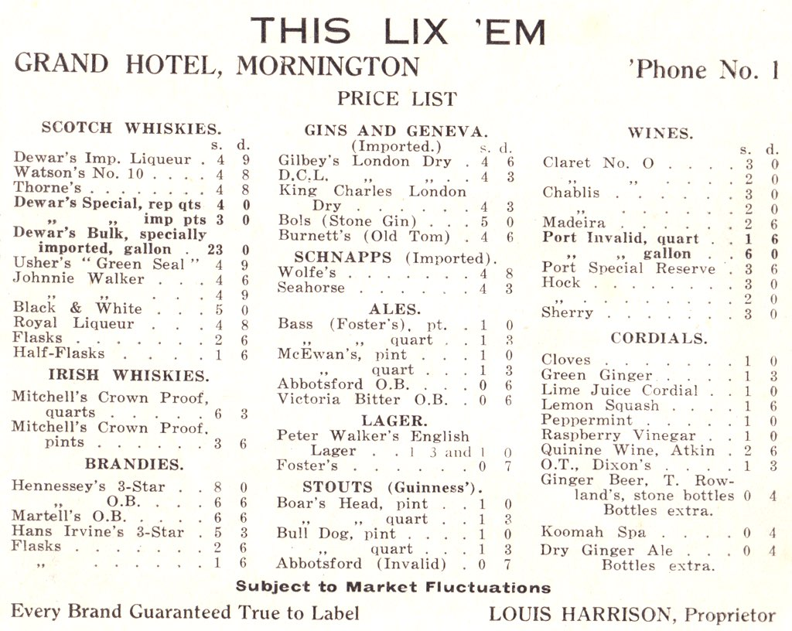

Slide 34
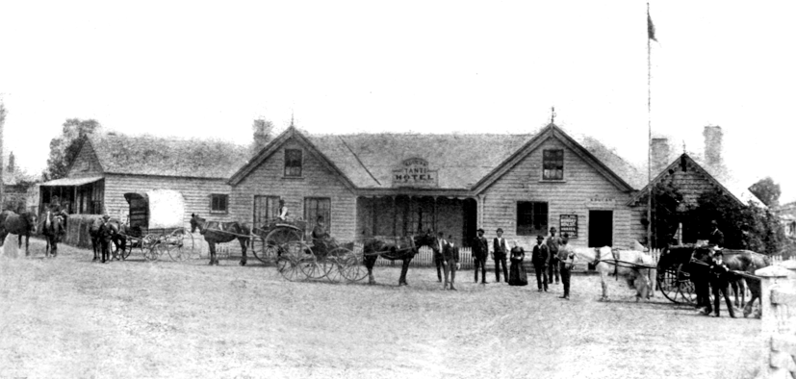
Tanti Hotel - rebuilt many times

Slide 35
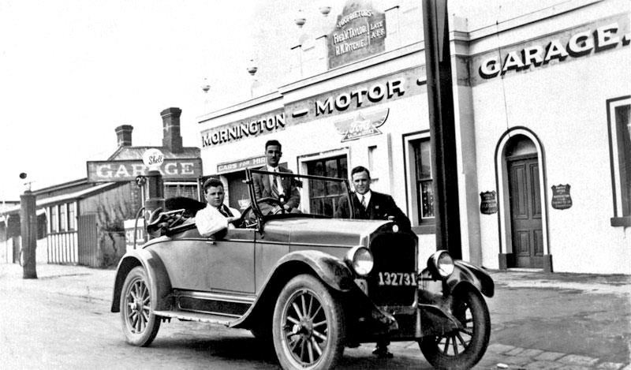
Taylor and Ritchie’s motor garage

Slide 36
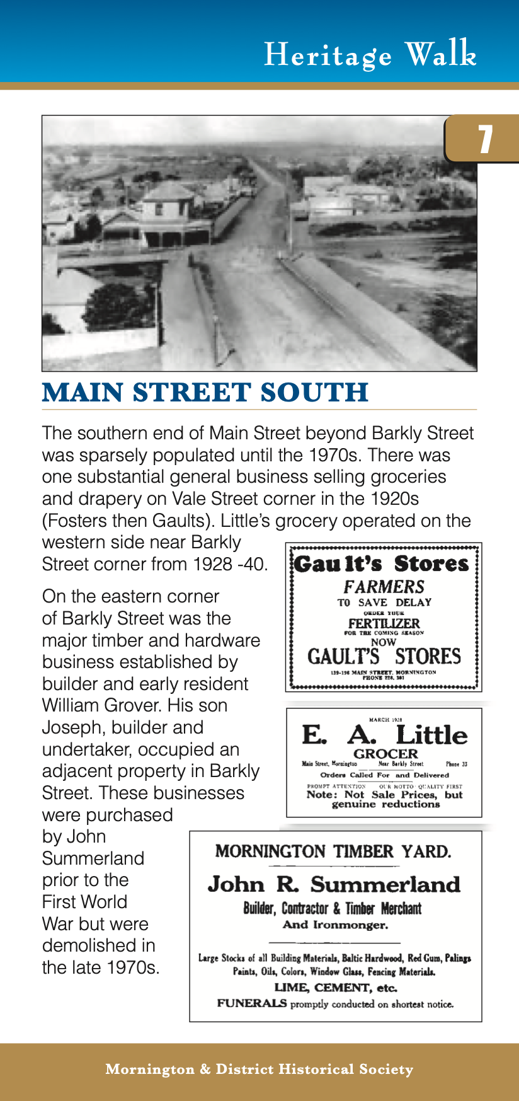
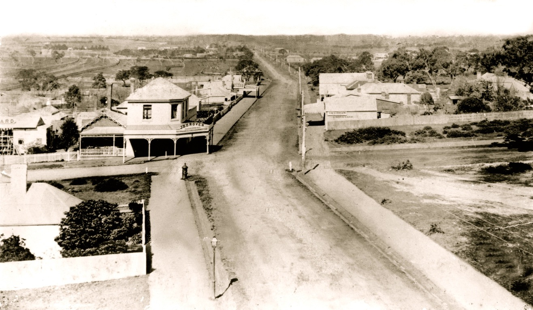

Slide 37

Joseph Grover and Family

Slide 38


Slide 39


Slide 40



Slide 41

Mornington Fire Brigade

Slide 42

Reels and ladder fire ready

Slide 43

Mornington competing in Fire Games

Slide 44


Plaza cinema was set back from street

Slide 45


Slide 46

. . . as you walk down to No. 78 - 81

Slide 47


Slide 48

A typical Main Street business

Slide 49


Slide 50


Barney Bradford WWI

Slide 51



Slide 52


Slide 53



Slide 54


Slide 55


Thomas Allchin

Slide 56


Slide 57

Allchin’s brick works

Slide 58


Slide 59

Sutton Grange

Slide 60


Slide 61



Slide 62


Slide 63


Slide 64


The billiard room at the rear of the cottage

Slide 65


Slide 66

One of the friezes in these 1930s shops

Slide 67


Slide 68

St. Peter’s Church, also the ‘English Church’

Slide 69


c.1910

Slide 70

Rankini’s advert

Slide 71


Operated by Nunns c.1914

Slide 72


Slide 73


Slide 74


Slide 75


c.1910

Slide 76

Cobb & Co Coach

Slide 77

Telegram 1870s

Slide 78

Telegram 1862

Slide 79

Telegram from Butchart of Beleura 1862

Slide 80



Slide 81

Esplanade guest house and hotels

Slide 82


Slide 83


Slide 84
The Audio Tour of Historic Main Street Mornington is supported through funding from the Australian Government’s 2013/14 Community Heritage Election Commitments
The Mornington & District Historical Society would like to thank:
Mr. Bruce Billson MP
The Mornington Chamber of Commerce
Councillor Bev Colomb
Mrs. Val Wilson OAM
Mr. Michael Collins
Mrs. Janet Groves
Mr. Mick Taylor
Mrs. Diane White
Lavender Hill Multimedia
iSite Media
Banana Graphics Pty. Ltd.
Evan Stampe

